Slide 1
Skype IM Pretty Printer
Excelsior Hack Day I Project by Dmitry Leskov

Slide 2
The Problem
Sometimes I need to email an excerpt from a Skype IM chat to a third-party
I would select, copy and paste that excerpt
However, the result is hard to read so I have to format it manually

Slide 3
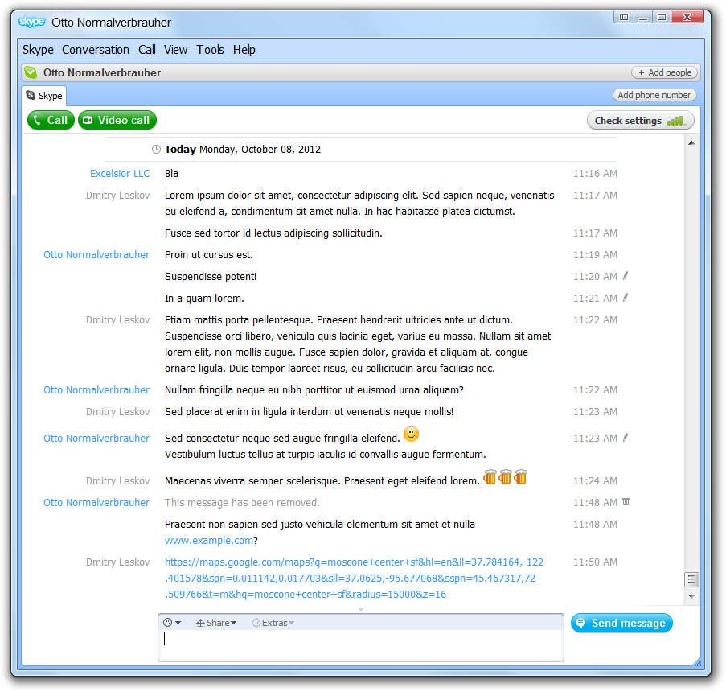
Nicely formatted chat…
Clearly seen participant names
Non-obtrusive timestamps
Visually separated messages
Clickable URLs
Emoticons

Slide 4
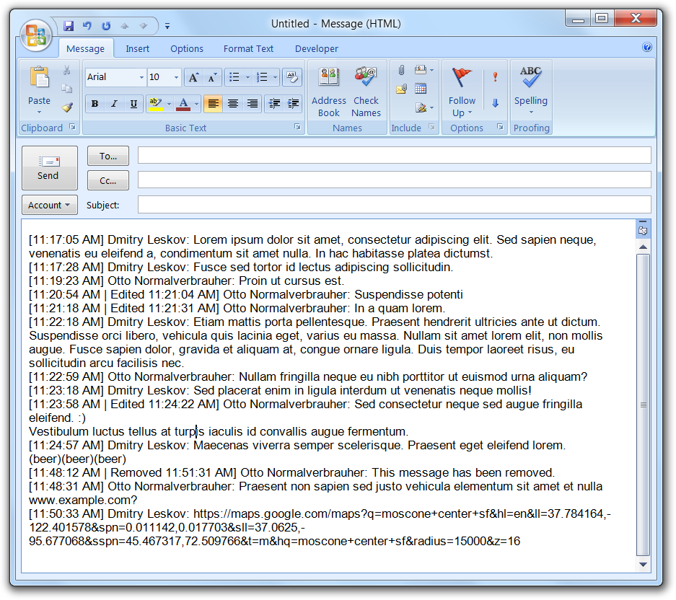
…turns into a character soup
One block of text
No date for fresh messages
Yet timestamps clutter the view
Authors hard to identify
Unrecognized URLs/emoticons

Slide 5
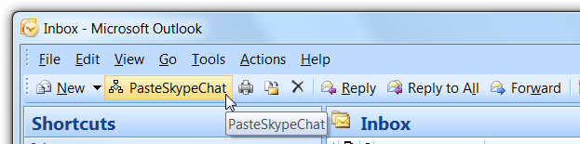
Solution
Outlook VBA to the rescue!
(What else would you have expected from a Director of Marketing, anyway?)
Just 200 lines of code and I have a button that…

Slide 6
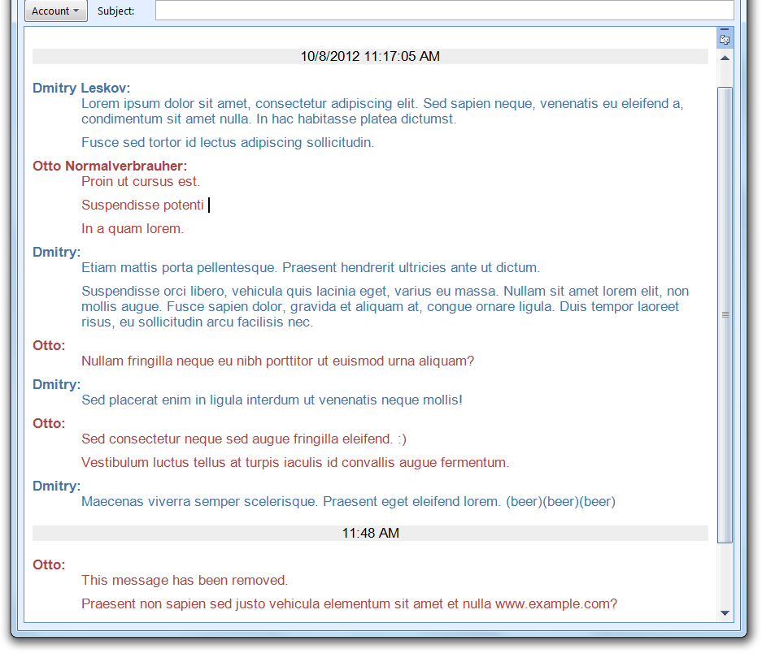
Pastes a nicely formatted chat!
Full date at top, timestamps after long breaks
Names typeset in bold, shortened on repeat
Space between messages

Slide 7
Todo
Recognize links
Recognize emoticons
Configuration parameters
Formatting templates

